Slide 1

DATA MODELLING
Divakar’s Presentation

Slide 2
Power Bi
Power BI is a powerful data visualization and business intelligence tool.
Data
Modelling
In Power Bi
Data Modeling
Data modelling is the process of structuring and connecting data and establishing the relationship between the tables.
Cardinality
Defines the nature/ type of a relationship between two tables, It has 4 Types.

Slide 3
Keys in
Data Modelling
Primary Key
Foreign Key
A Primary Key is a table which has unique Values.
There is no repetition/ Duplication in Values.
The table which is holding the primary key is called as "Dim Table" or "Dimension Table“
The table have only one primary key.
A Foreign Key is a column or set of columns in one table that corresponds to the primary key in another table used in establishing a relationship.
It can have duplicate values.
The table which is holding the Foreign key is called as "Fact Table" or "Child Table“
Here the table can have multiple foreign keys, each linking to a different primary key in another table.

Slide 4
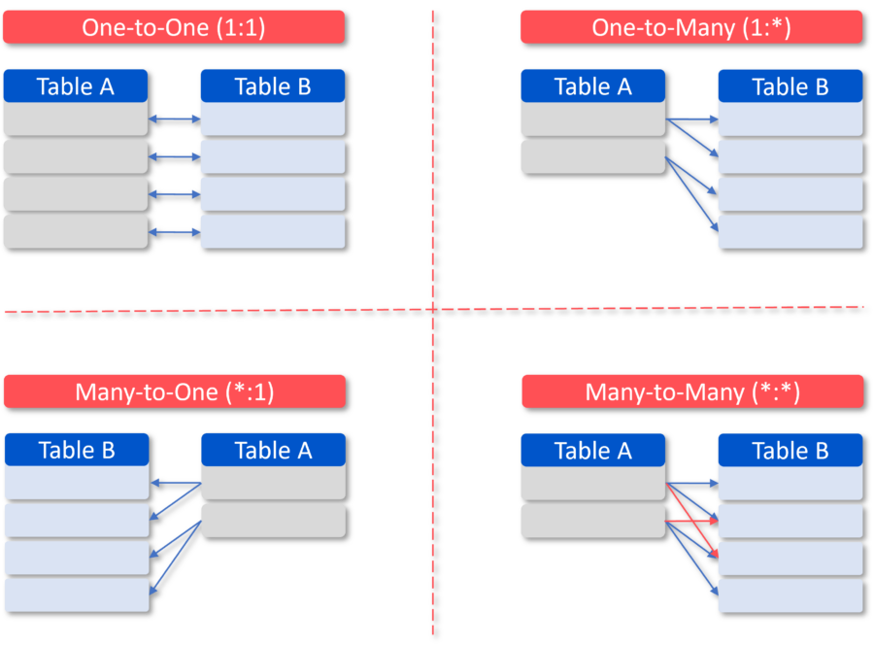
Types of Cardinality
One-to-One (1:1)
One-to-Many (1:*)
It occurs when, each row in table A is associated with only one row in table B
One row in a specific table is related to multiple rows in another table. It is one of the most commonly used forms.
Here Both table acts as primary key
One table will act as primary key and other will act as Foreign key
Many-to-One (*:1)
Many-to-Many (*:*)
The reverse of a one-to-many relationship.
Multiple rows in a table is related to one row in another Table
Multiple Rows in Table A can be linked to multiple rows in Table B, and vice versa.
Here both table has duplicates values.

Slide 5
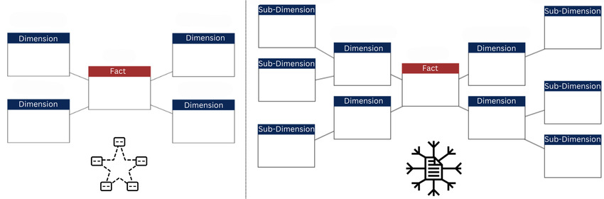
Schema in
Data Modelling
(nothing but a Database)
Star Schema
Snowflake Schema
In this the centre has fact table surrounded by dimension tables, forming a star-like pattern
The central fact table contains quantitative data (e.g., sales), while the dimension tables hold descriptive attributes related to the facts (e.g. Employee, Date, Territory).
Fact in centre >> Connected to dimensions
Here a dimension table can be further split into additional related tables
Fact (Sales) + Dimension (Product → SubCategory → Category, Date → Fiscal Calendar, etc.).
Fact in centre >> Connected to dimensions >> Connected to dimensions

Slide 6
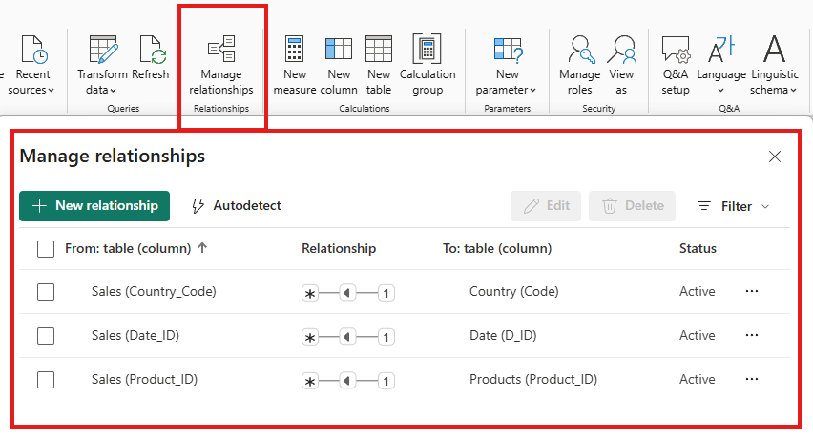
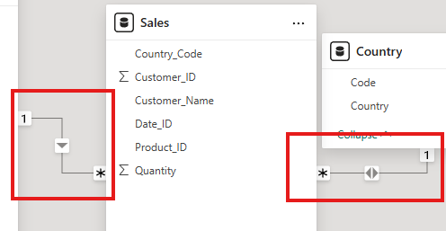
Examples and Additional Things
Manage Relationships
Cross-Filter Direction
Here we can view, create, edit, and delete relationships between tables in your data model
Pipeline,
Single-headed arrow
And Double-headed arrow

Slide 7
Why is Data Modelling Important?
Simplifies Reporting and Analysis
Structured data model makes easy to maintain and update reports as the business evolves
Data modeling helps minimize errors
Avoids duplicate or wrong calculations

Slide 8


